Slide 1





“The trusted partner you can count on”
Canadian standards you can trust.

Slide 2
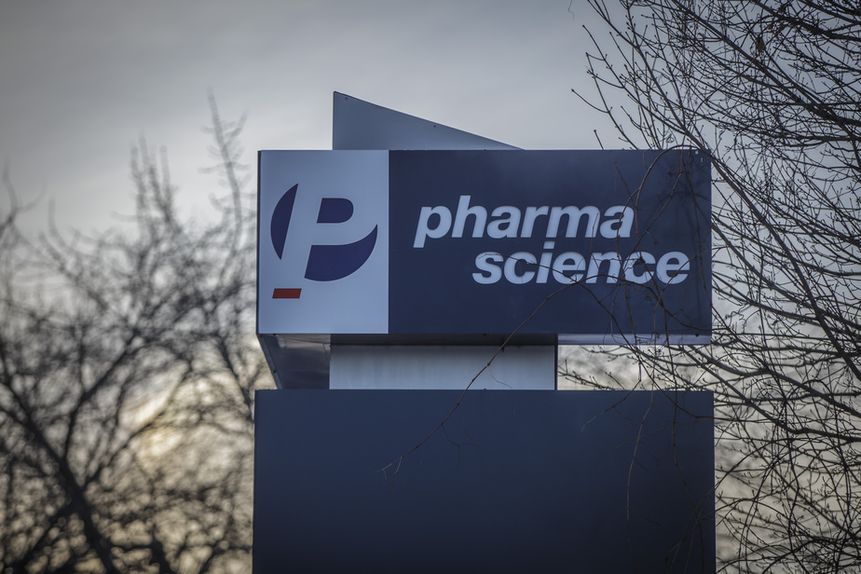
THE
PHARMASCIENCE
DIFFERENCE
Delivering Value Based Partnering that is aligned to your healthcare objectives
Canadian standards you can trust.
Notes:
Change photo (put in sign)

Slide 3



A NEW ERA OF HEALTHCARE CHALLENGES
Financial considerations and human concerns
86% of all healthcare costs are associated with managing chronic disease
COVID-19 continues
to impact healthcare, economics, and social norms around the world
Healthcare spending is projected to consume 9.5%–14% of global GDP by 2060
The aging population is significantly driving the rise in costs, 61% increase in morbidity due to cardiac conditions, cancer and infectious disease by 2030
Canadian standards you can trust.
Notes:
Maintain blue and red logo

Slide 4



NAVIGATING THE EVOLVING HEALTHCARE LANDSCAPE
Overcoming challenges to meet expectations
Your are EXPECTED TO
While you DEAL WITH
High unpredictability
for the future
Manage changing demands
Ensure the highest quality
Resource & Time constraints
Improve cost-effectiveness
Budget constraints
Canadian standards you can trust.

Slide 5
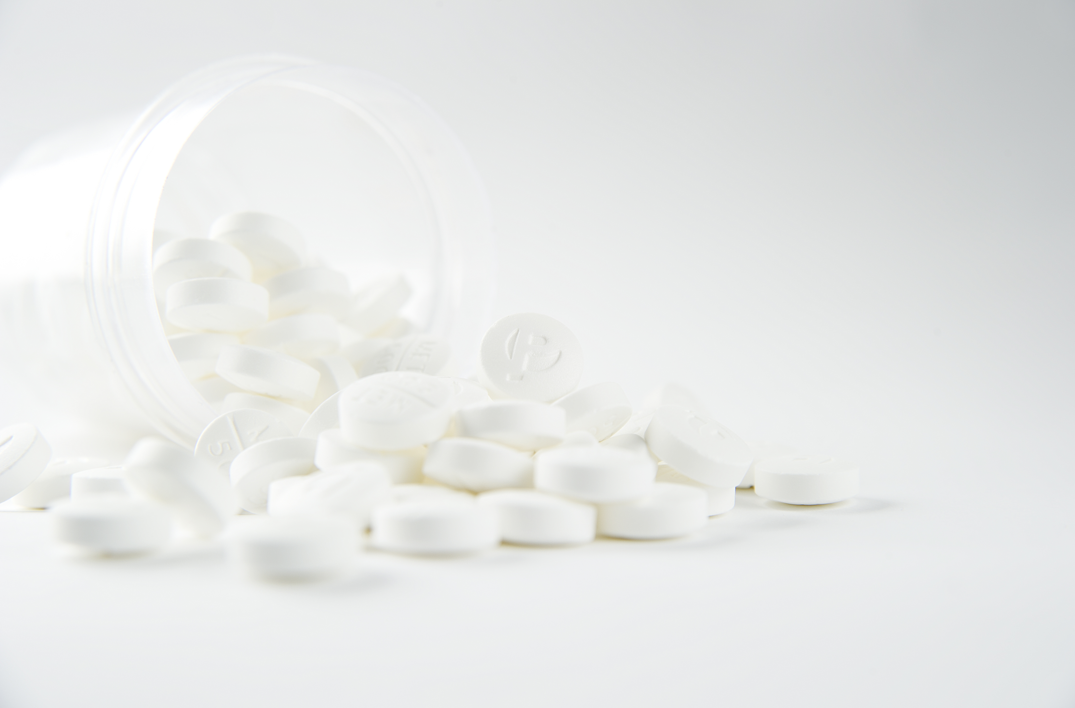

PHARMASCIENCE ALIGNS WITH CUSTOMER KEY VALUES
IN SUPPORT OF HEALTHCARE SUSTAINABILITY
Working Towards
Healthcare Sustainability
High quality medications
Reliable Supply
Increased Patient Access
Customer Enablers
Innovation
Compliance
Accessibility
Financial & resource management
Trusted & reliable partners
Customer
Key Values
Medical Value
Resource Optimization
Risk Management
Compliance
High Quality Manufacturer
Reliable Supply Chain
Local & Global market expertise
Our People committed to customer experience
Diverse manufacturing & commercial capability
Pharmascience Advantage
Canadian standards you can trust.

Slide 6





PHARMASCIENCE ALIGNS WITH CUSTOMER KEY VALUES
IN SUPPORT OF HEALTHCARE SUSTAINABILITY
MEDICAL VALUE
  High quality products
  Product clinical evidence
  Improve patient therapies
  Elevate patient access
RESOURCE OPTIMIZATION
  Product reliability
  Cost effective solutions
  Supply predictability
  Comprehensive supply chain
COMPLIANCE
  Quality by design, bioequivalency
  International regulatory compliance
  Stringent documentation :100% Quality control verification
  Environmental, Health and Safety adherence
RISK MANAGEMENT
  Trusted & transparent partnership
  Reliable supply
  Canadian product quality
  Operational continuity
Canadian standards you can trust.

Slide 7
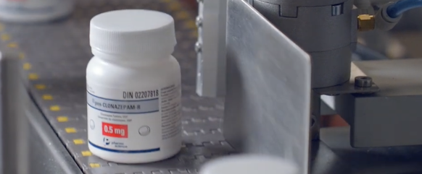
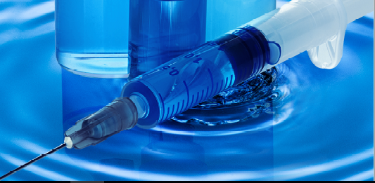
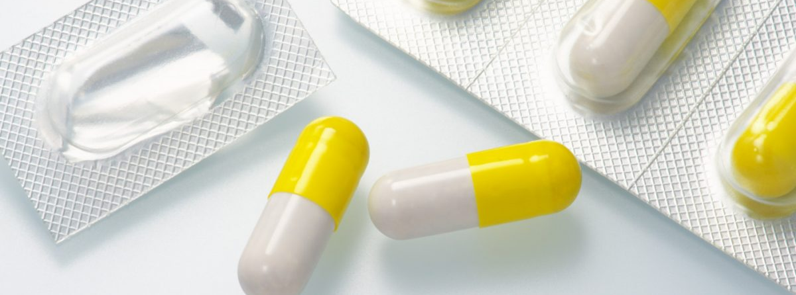
Pharmascience is your strategic partner focused on co-creating the future of healthcare
Pharmascience partnership advantage…
1
Accesses high quality medicines
Delivering high quality Canadian products you can trust, including specialty products
Delivers reliable supply
via Pharmascience’s innovation in supply operations enabling cost-effective solutions
Increases your capabilities
with Pharmascience’s R&D investments, business development capabilities, and expansive product portfolio
2
3
Canadian standards you can trust.

Slide 8
Pharmascience
Roots

Slide 9
Pharmascience Inc. was founded by pharmacists Morris Goodman and Ted Wise in 1983, with the goal of bringing affordable and accessible high quality medicine to Canadians and patients world wide.
Morris Goodman & Ted Wise
”Real success is being able to give back to your community” - Morris Goodman
Canadian standards you can trust.

Slide 10
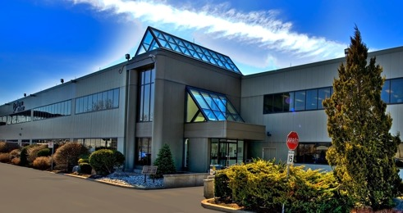


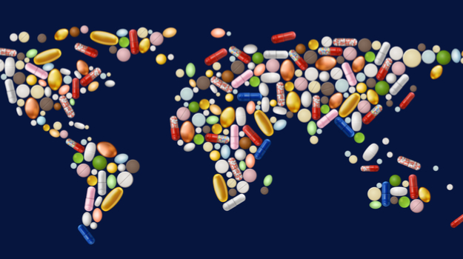

“
“
We believe in improving the health and well-being of
Canadians and people in need around the world.
Headquartered in Montreal, Canada.
We are a top pharmaceutical manufacturer delivering high quality medicines globally.
Canadian standards you can trust.

Slide 11




CUSTOMER FOCUS
INNOVATION
PHILANTHROPY
Our core values, passion for customer focus, and commitment to healthcare sustainability for patients are the driving force behind everything we do.
Canadian standards you can trust.

Slide 12




Giving back to communities is part of Pharmascience’s DNA
+ 70 MILLION
Donated to date
to Health Partners International Canada (HPIC)
+ 3 MILLION
Lives improved across 100 Countries
INTERNATIONAL
events supporting children and adult patients around the world
Canadian standards you can trust.

Slide 13
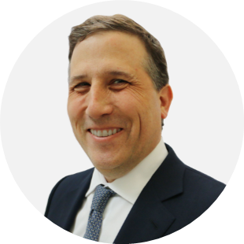
PHARMASCIENCE YOUR WORLDWIDE PARTNER
“
"Since Pharmascience was founded, we have invested over $500 million in R&D. We are committed to becoming a world leader in pharmaceutical manufacturing, while also being recognized as a multifunctional centre of R&D excellence.”
- Dr. David Goodman
“
Dr. David Goodman
CEO
Canadian standards you can trust.

Slide 14









THE PHARMASCIENCE JOURNEY TO A WORLDWIDE PRESENCE
1994
Eastern European business operations in Kiev, Ukraine.
1990
Hong Kong & Jamaica business operations.
1983
Founded by Canadian pharmacists, Morris Goodman & Ted Wise. R&D activities began.
1996
Creation of state-of-the-art research laboratories pilot production plant.
1998
Pharmascience Global Headquarters in Canada.
2003
Acquisition of Pangeo, a Canadian pharmaceutical company.
2014
Saudi Arabia business operations.
Acquisition of Uman Pharma Inc.
2012
South Korea business operations.
2010
Introduction of the
Pendopharm specialty drug division.
2007
Vietnam business operations.
Continued Global Expansion
2017
Busulfan – First product launch in the US.
2018
FDA approved Bioanalytical facility.
2020
Central Eastern Europe business operations.
United Arab Emirates business operations.
Canadian standards you can trust.

Slide 15

Pharmascience International
In Focus
Notes:
Consider world focus transition slide

Slide 16




YOUR HIGH-QUALITY
CANADIAN MANUFACTURER
Supporting worldwide healthcare organizations
Sterile injectable and high potency solid oral dosage manufacturing sites
The only plant in North America with cytotoxic capabilities in all dosage forms
Annual production capacity of 2.5 billion units in finished dosage forms
State of the art operational facilities, expanding production capacity and reducing cycle times
“The trusted partner you can count on”
Canadian standards you can trust.
Notes:
Consider city focus image

Slide 17
Pharmascience delivers high-quality Canadian medications to patients around the world, including primary and specialty therapeutic areas
THERAPEUTIC AREAS
Cardio
Pain
Musculo-
skeletal
Central Nervous System
Anti-infective
Urology
Oncology
Respiratory
Gastro ( GI)
Canadian standards you can trust.

Slide 18
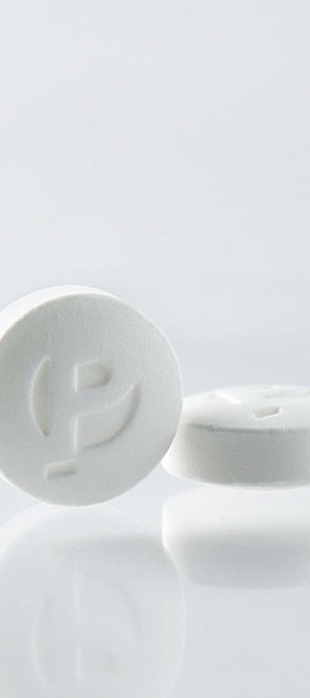

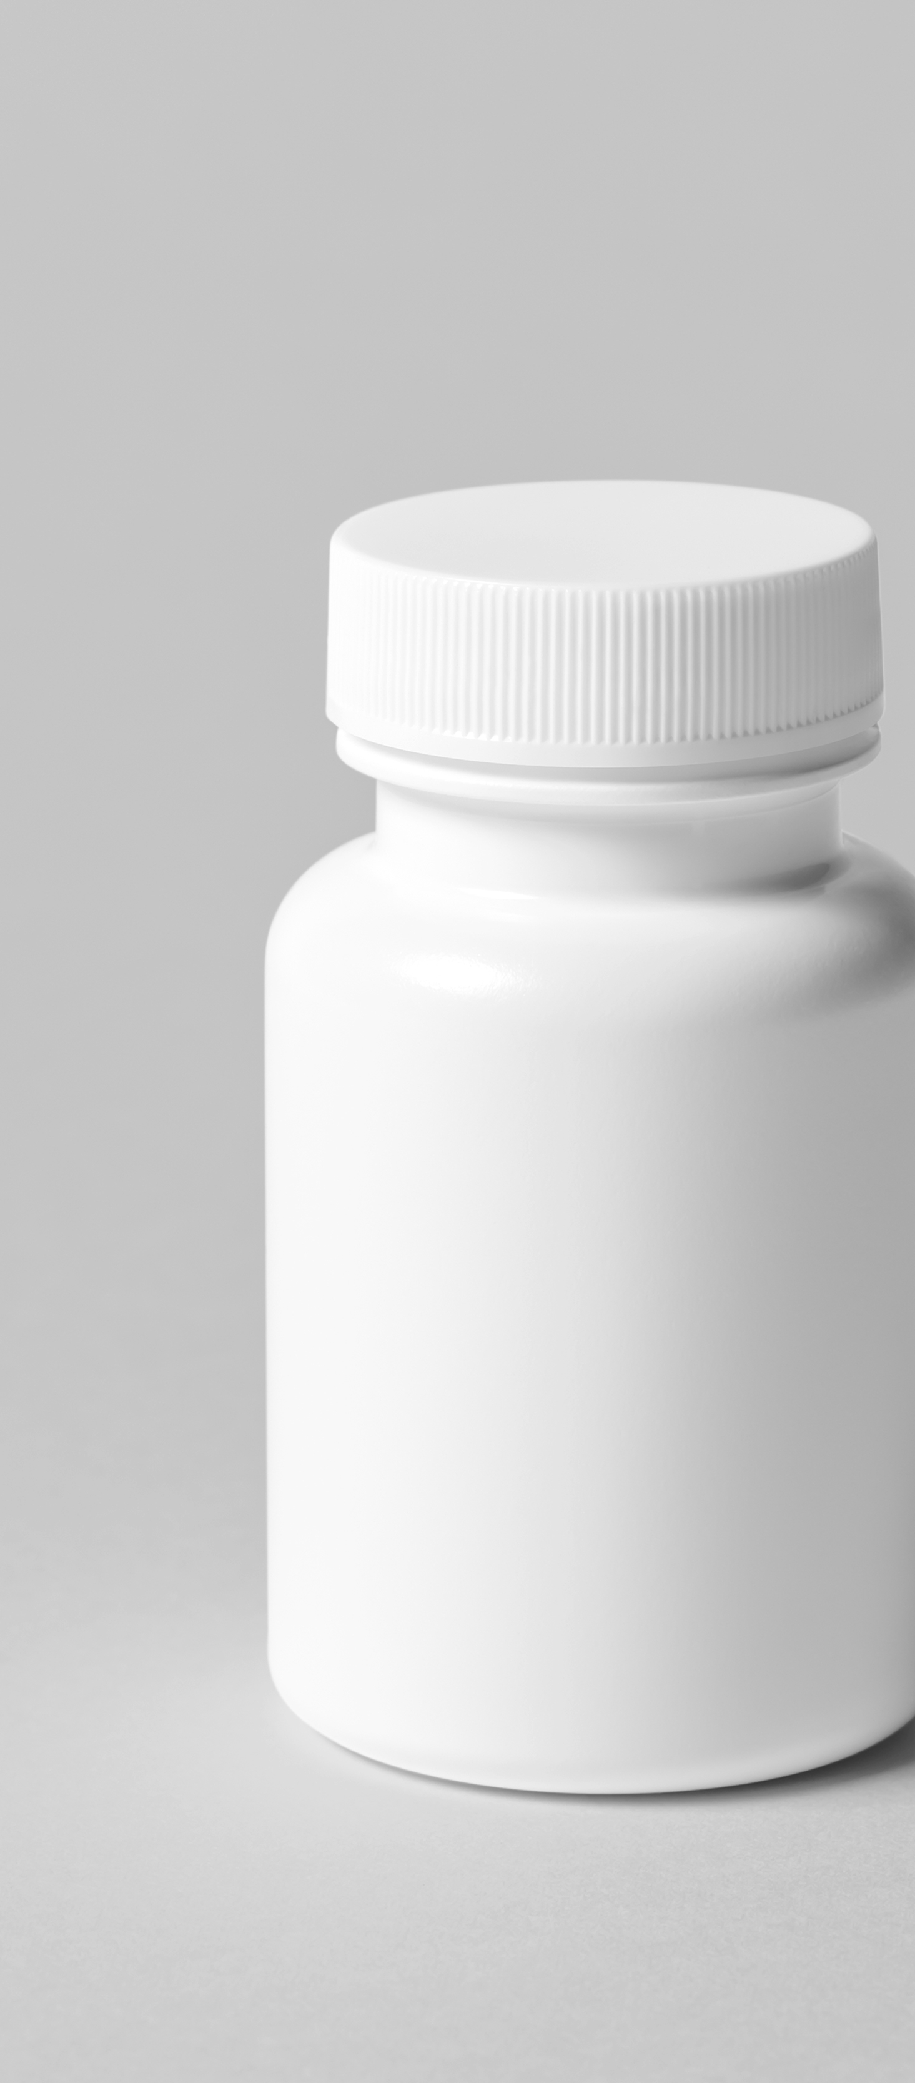
Manufacturing Excellence
& Strict Adherence
Unparalleled Customer Service
Innovative Technologies
Proven Success in the Pharmaceutical Industry
FDA, European Medicines Agency & Health Canada approved manufacturing sites and strict Good Manufacturing Practices (GMP) adherence
Service excellence maintained throughout the year with a distinctly high Customer Service Level
Innovation integration with AI for highly accurate resupply planning, shortage prediction, and variability reduction
Over 35 years of experience you can trust to co-create custom solutions that respond to your needs
Canadian standards you can trust.

Slide 19
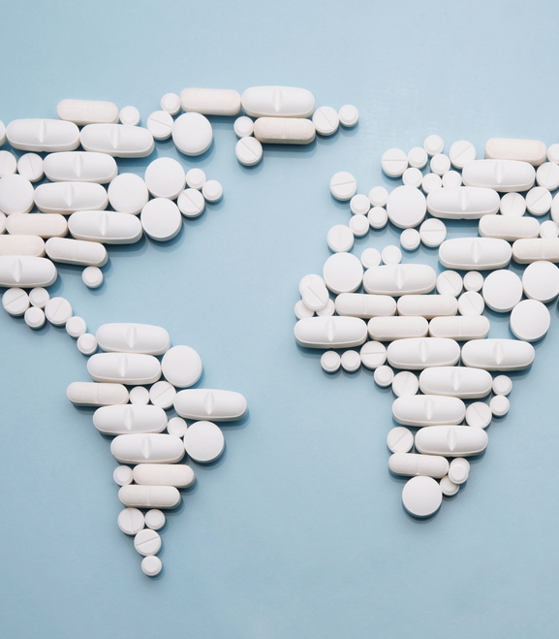

Pharmascience has the business & operational capabilities to meet your needs
ORGANIZATIONAL CAPABILITY
DIVERSE BUSINESS MODELS
Manufacturing & Supply Chain Innovation
CMO & CDMO
In/Out-Licensing
Research & Development
B2D
Business to Distributor
B2B
Business to Business
B2C
Business to Customer
Canadian standards you can trust.

Slide 20







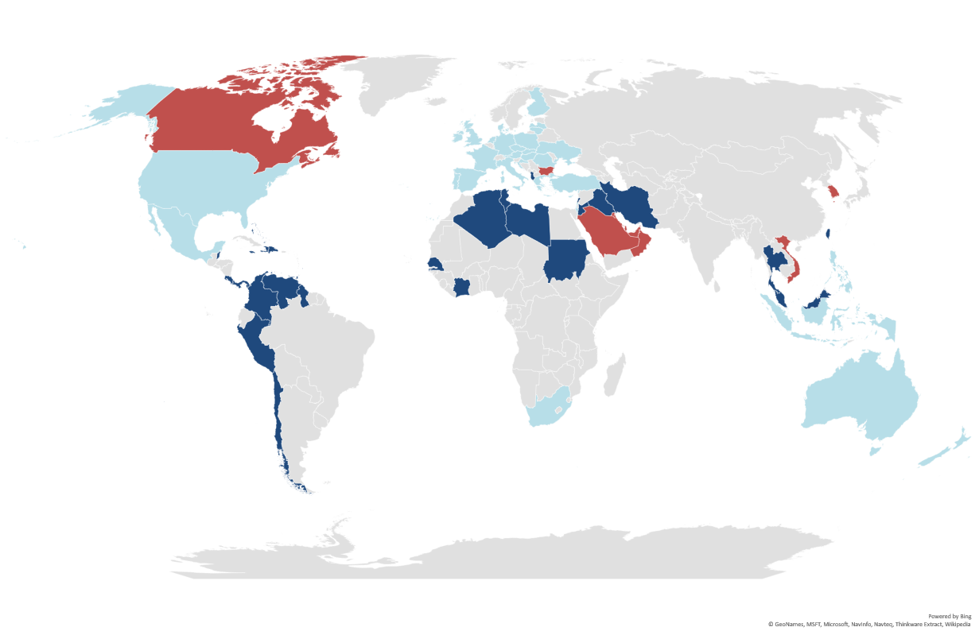
Pharmascience delivers global & regional market expertise
Canada
Europe
USA
South Korea
MEA
Mexico
KSA/GCC
APAC
LATAM
>50
COUNTRIES
Ensuring strong market understanding to support customer needs
Operational presence in 5 core regions
Canadian standards you can trust.

Slide 21



QUALITY & SAFETY YOU CAN TRUST
The Pharmascience Difference
HIGHEST QUALITY PRODUCTS
Investment in Quality by Design approaches, and the necessary requirements to ensure bioequivalency to the reference product
Pharmascience products are developed and distributed with the highest regulatory standards and best industry practices
COMPLIANCE BY INTERNATIONAL REGULATIONS
Approvals from active members of ICH and PIC/S, including Health Canada, EMA, and US FDA, ensuring the safest, most effective and highest-quality medicines are developed.
STRINGENT DOCUMENTATION
Quality documentation is 100% verified by highly skilled Quality Control staff, and thoroughly reviewed by Quality Assurance staff.
Canadian standards you can trust.

Slide 22
THE
PHARMASCIENCE
DIFFERENCE
Delivering Value Based Partnering
High quality Canadian medications
Manufacturing excellency, supply reliability & cost-effectiveness
Professional in-market expertise with a human touch
Trusted partnership ensuring a customer-centric experience
Canadian standards you can trust.

